Slide 1
CREATE MUSIC GROUP · DATA SCIENCE INTERN CASE STUDY
Monthly Accruals
Forecasting Framework
Revenue & RPS Estimation & Insights · Jan-Oct 2025
Swapnil Dubey · sdubey14@student.ubc.ca · March 2026

Slide 2
PROBLEM STATEMENT
Why does Finance need this?
⏱
📊
🎯
Payout Delay
Incomplete Picture
What We Need to Build
DSP revenue for a given month (e.g. September) trickles in over the following 2-3 months. Finance can't close their books without estimates.
Without estimates for missing months, Finance sees large gaps - making it impossible to track performance or plan accruals accurately.
A system that identifies which months have complete data, flags the rest, and fills the gaps with defensible revenue + RPS estimates.
Key assumption provided: streams are complete for every month, even when revenue is not.

Slide 3
DATA OVERVIEW & CLEANING
Two sources. Two problems. One clean dataset.
Revenue Sheet
Streams Sheet
3,534 rows
26,036 rows
month · business_unit · dsp · territory · revenue
month · business_unit · dsp · country · streams
27 raw DSP variants
9 null revenue values (Apple BU3, isolated)
10 territory buckets
Already clean - 5 DSPs
200+ granular countries
Streams complete for all months
Key Cleaning Decisions
27 DSP revenue variants → 5 bucket DSPs (Spotify, YouTube, Apple, Amazon, TikTok): As seen in Streams data
200+ stream countries → 10 territory buckets to match Revenue granularity (left join on Streams preserves all data)
9 null Apple BU3 revenue rows → estimated via RPS baseline rather than filled with 0 (prevents $0 revenue appearing in otherwise complete Actual months)

Slide 4
ACTUAL VS FORECAST - FLAG LOGIC
How do we know if a month's data is complete?
When revenue is missing/incomplete, it drops to near-zero across all territories simultaneously - suggesting DSPs report at the statement level rather than territory-by-territory. We therefore assess completeness at the DSP+month level by aggregating total revenue per DSP per month and comparing it to a historical baseline.
The Rule
Why 20%?
If a DSP's total revenue for a month is less than 20% of its Jan-Aug historical average → flag as Forecast.
Otherwise → Actual.
The data shows a natural gap - incomplete months are all under 1% of historical average (e.g. Spotify Sep = $0, Amazon Sep = $61). Complete months are all above 90%. Any threshold between 1-90% produces identical results. We chose 20% as a conservative, interpretable cutoff with clear distance from both extremes.
1,720
280
7
Actual rows
Forecast rows
DSP+month combos forecasted

Slide 5
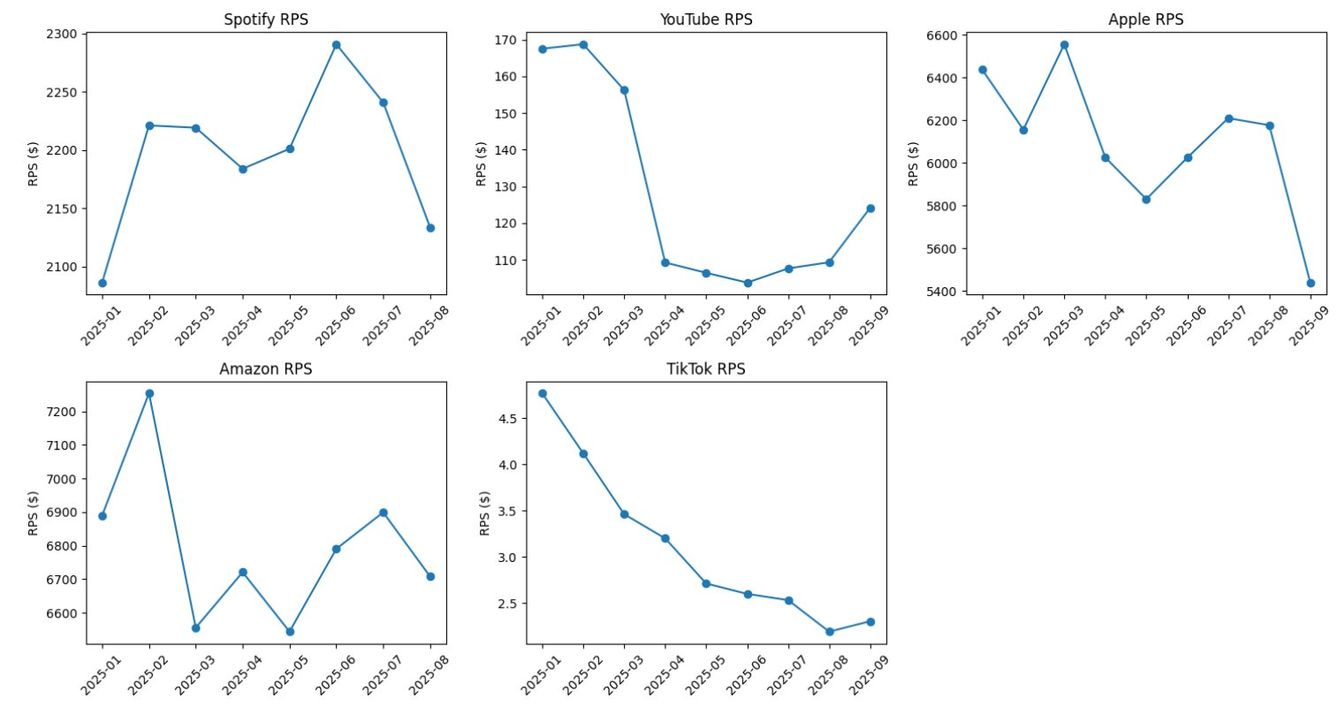
FORECASTING METHODOLOGY
RPS-based forecasting - anchored to actual stream activity
Forecasted Revenue = Streams (complete) × Trailing RPS Baseline ÷ 1,000,000
Why streams-based RPS? The problem statement explicitly states streams are complete - making them the ideal anchor. This approach uses real Sep/Oct activity rather than blind extrapolation from past revenue alone. RPS is also the secondary metric Finance requested, so it falls out naturally from our methodology.
Spotify / Apple / Amazon
Trailing 3-month RPS (Jun-Aug)
CoV < 0.06 - highly stable
TikTok
Trailing 3-month (Jun-Aug)
CoV is relatively higher & RPS Steady decline - older months would overestimate
YouTube
Apr-Aug baseline (5 months)
CoV is relatively higher & RPS dropped sharply in April and stabilized at a new level, suggesting pre-April data is no longer representative. Using all 5 post-April months for a more stable baseline.

Slide 6
OUTPUT FOR FINANCE
One unified table - actuals and forecasts, flagged and ready
month
total_streams
Period (2025-01 to 2025-10)
Complete for all rows
dsp
total_gross_amount
5 Bucket DSPs
Actual or RPS-estimated revenue ($)
business_unit
flag
BU 1-4
Actual / Forecast
country
RPS
10 territories incl. “All Other Locations”
Revenue per million streams
2,000 rows · Jan-Oct 2025 · 5 DSPs · 4 BUs · 10 territories · Delivered as Excel

Slide 7
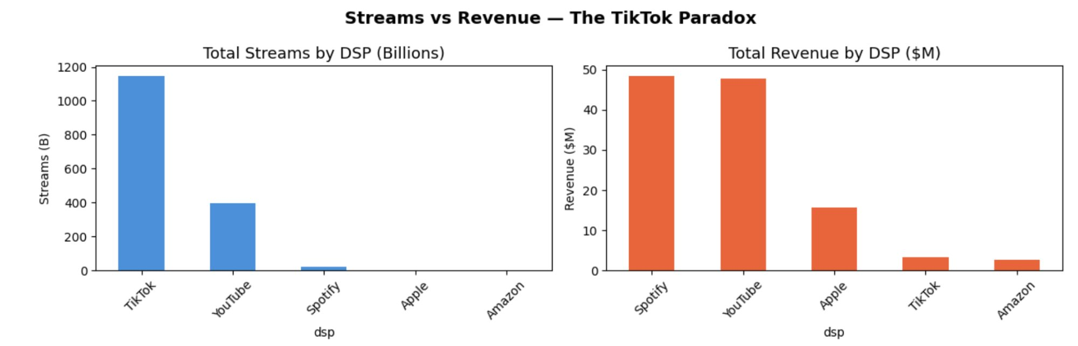
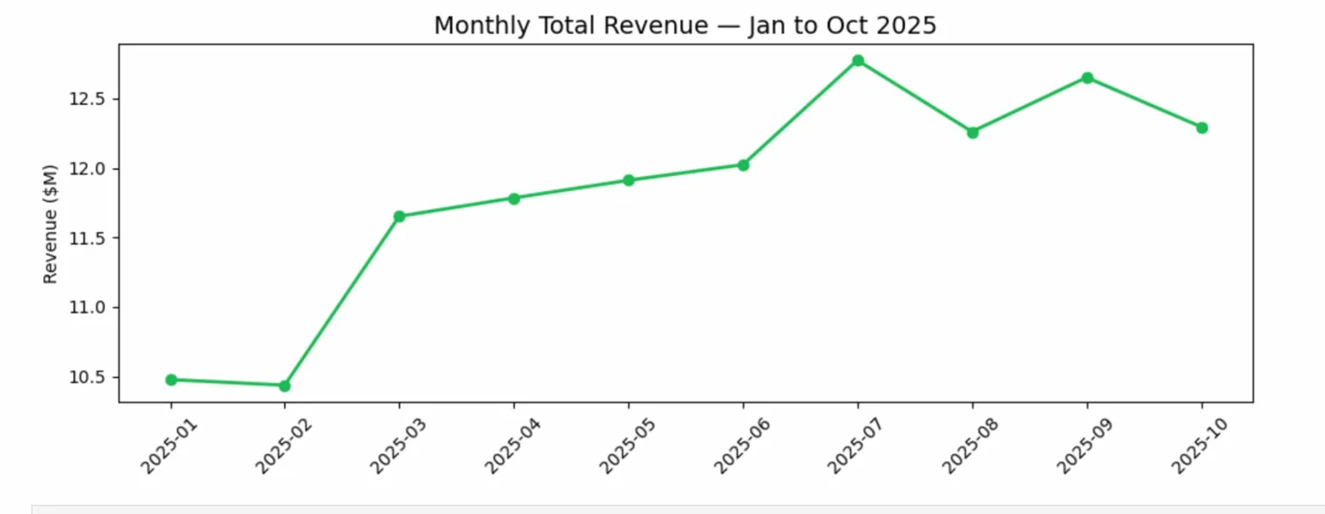
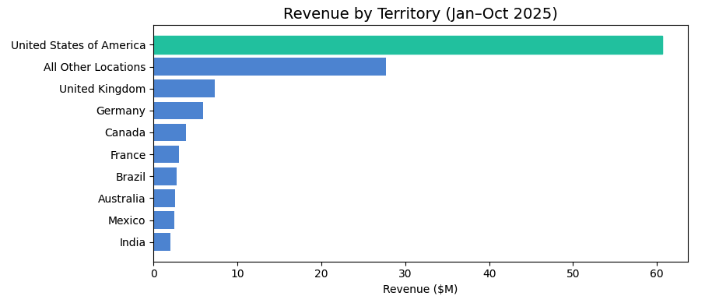
BONUS - KEY PATTERNS & INSIGHTS
What the data reveals beyond the accruals problem
01
The TikTok Paradox
TikTok drives 66% of all streams but generates only 3% of revenue. Its RPS of ~ $2–3 vs Spotify's $2,200 per million streams makes it the lowest-value DSP by a significant margin despite massive volume.
02
Revenue Growing 17%
Total monthly revenue grew from $10.5M in January to ~$12.5M by mid-year - a healthy upward trend. Jul 2025 was the peak month at $12.8M.
03
US Accounts for 51% of Revenue
The United States generated $60.7M - over half of total revenue - despite being one of 10 reported territories. UK and Germany are distant second and third.

Slide 8
SUMMARY
What was delivered
Unified revenue + streams dataset across 5 DSPs, 4 BUs, 10 territories - Jan to Oct 2025
Actual vs Forecast flag for every row, determined at the DSP+month level
RPS-based forecasting using trailing 3-month baselines, with DSP-specific adjustments for YouTube and TikTok
Final Excel output ready for Finance team accrual reporting
3 bonus insights surfaced from the data including the TikTok monetization gap and 17% revenue growth
Swapnil Dubey · sdubey14@student.ubc.ca

